Slide 2
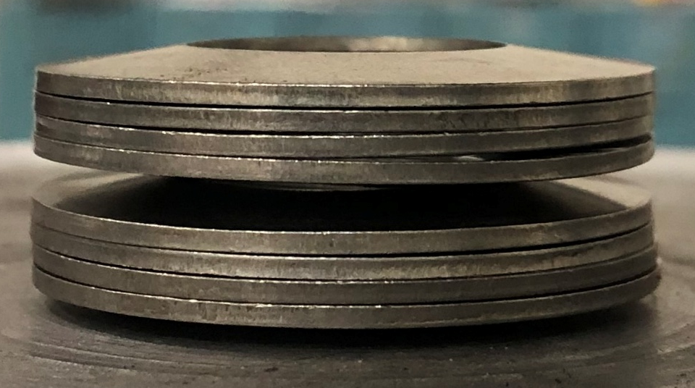

Slide 3
No. | Units |  | Stack
 | Configuration | Naming
1 |  | 1U
2 |  | 1D
3 |  | 1U1D
4 |  | 2U2D | Example: Stack consisting of 2 units of 2U2D
5 |  | 3U3D

Slide 4
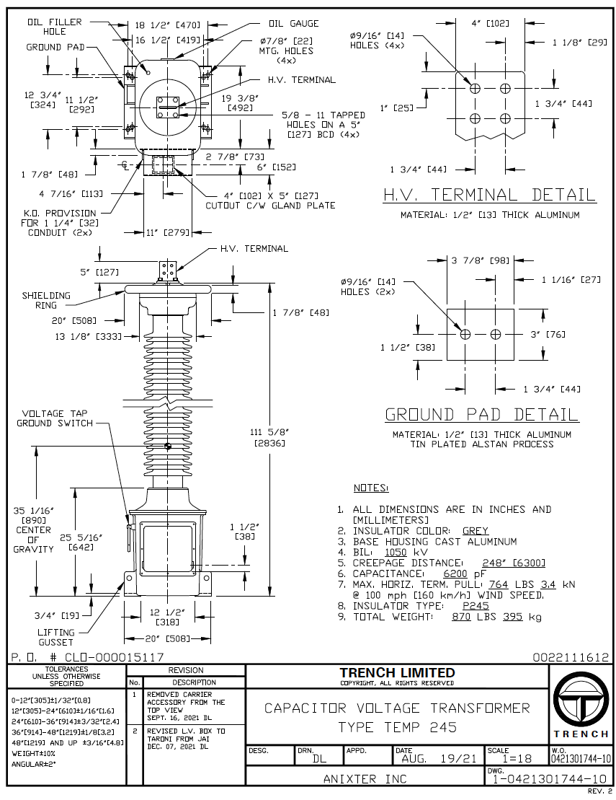

Slide 5
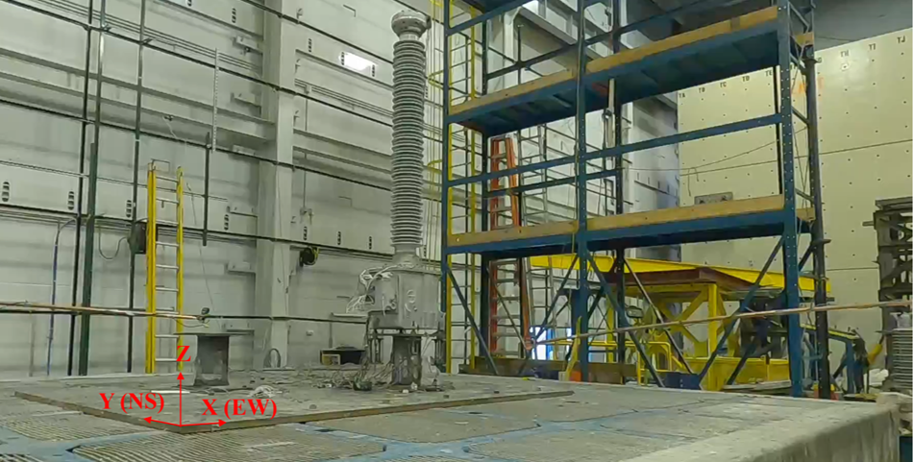
CVT
Belleville washers
Spool
Shake table

Slide 6
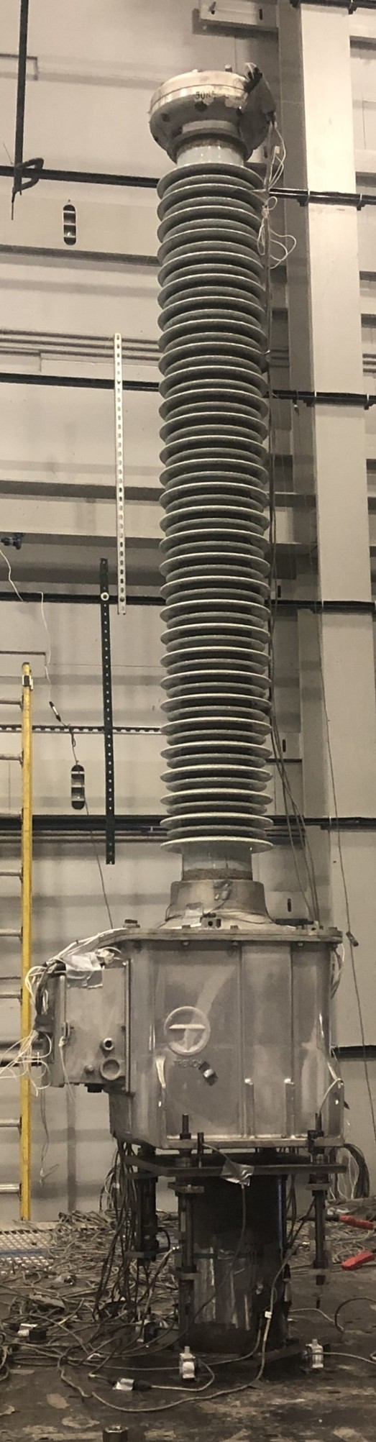
Top acceleration
and displacement, X and Y
Mid acceleration, X and Y
Strains at Bushing base
N, S, E and W
CVT box acceleration, Z
in N, S, E and W
Z
Y
X

Slide 7
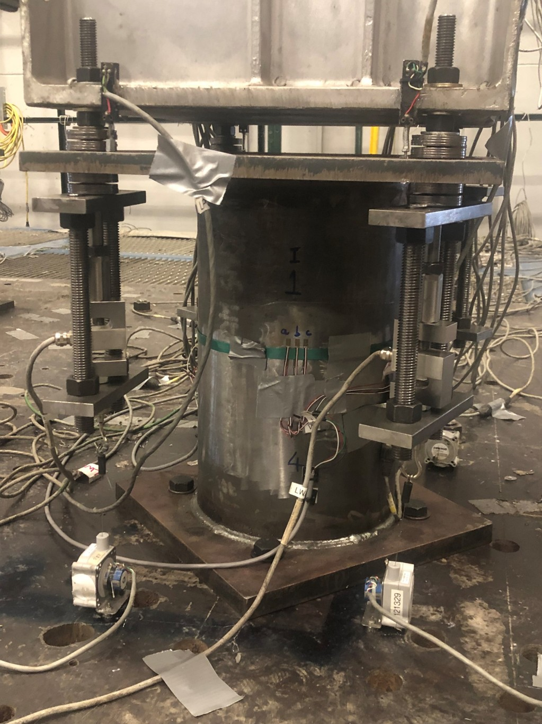
Top stack deformation
4 LWAs, each corner
Moment, X and Y
Z
Spool
Y
X

Slide 8
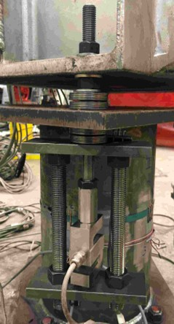
Z
Nut used to apply preload
Y (NS)
Spool top plate
X (EW)
K1875 2 units of 2U2D
Spool
3/4in rods to complete load path
Load cell

Slide 9
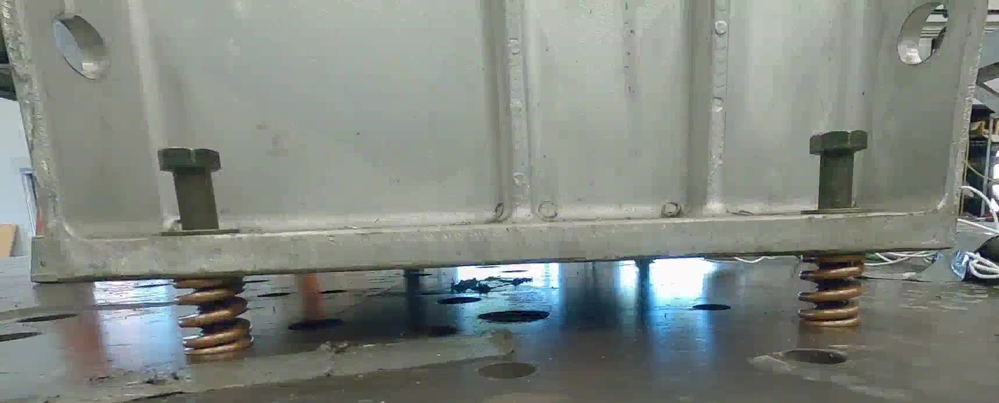
CVT base
Guide bolt
2,120 lb/in springs
at four corners
Floor

Slide 10



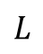
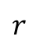
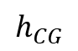
Cut 1 is at mid-spool
$$I_{0}\ddot{θ}$$
$$m{\ddot{x}}_{t}$$
$$mg+m{\ddot{z}}_{t}$$
$$h_{CG}$$
Z
Z
Y
X
Y
X
$$L$$
$$r$$
R
V
LWA
2
LWA
1
LWA
2
LWA
1
M_{spool}

Slide 11
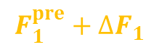
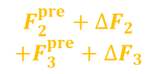
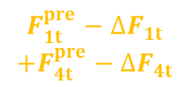
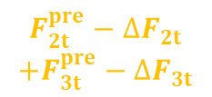
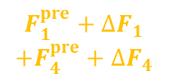

Cut 2 is at mid-spool and CVT base
$${F_{2t}^{pre}−∆F}_{2t}$$
$$+{F_{3t}^{pre}−∆F}_{3t}$$
$${F_{1t}^{pre}−∆F}_{1t}$$
$$+{F_{4t}^{pre}−∆F}_{4t}$$
Z
$${F_{2}^{pre}+∆F}_{2}$$
$$+{F_{3}^{pre}+∆F}_{3}$$
$${F_{1}^{pre}+∆F}_{1}$$
$$+{F_{4}^{pre}+∆F}_{4}$$
O
Y
X
V₁
V₂
R
r
LWA
2, 3
V
LWA
1, 4
Z
M_{spool}
_{b}
_{b}
Y
X
Cut 3 is above LWA1
$${F_{1b}^{pre}+∆F}_{1b}$$
$${F_{1}^{pre}+∆F}_{1}$$
Cut 2
Cut 3
LWA
2
LWA
1
LWA
1

Slide 12


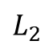
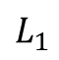

Cut 4 is at insulator base
$$I_{0ins}\ddot{θ}$$
$$m_{ins}{\ddot{x}}_{t,ins}$$
$$m_{ins}g+m{\ddot{z}}_{t}$$
$$L_{1}$$
R_{ins}
$$L_{2}$$
Z
M_{ins}
V_{ins}
Y
X
O
O
Cut 3
LWA
2
LWA
1

Slide 13
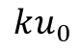
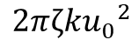
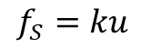
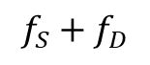
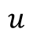
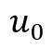
$$f_{S}+f_{D}$$
$$f_{S}=ku$$
$$ku_{0}$$
$$u$$
$$u_{0}$$
$$2πζk{u_{0}}^{2}$$

Slide 14
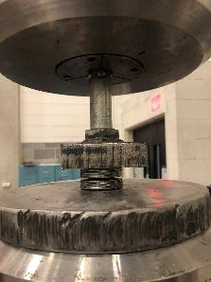
Material Testing
Machine
Loading
plates
K1875-G-086
2 units of 2U2D

Slide 15
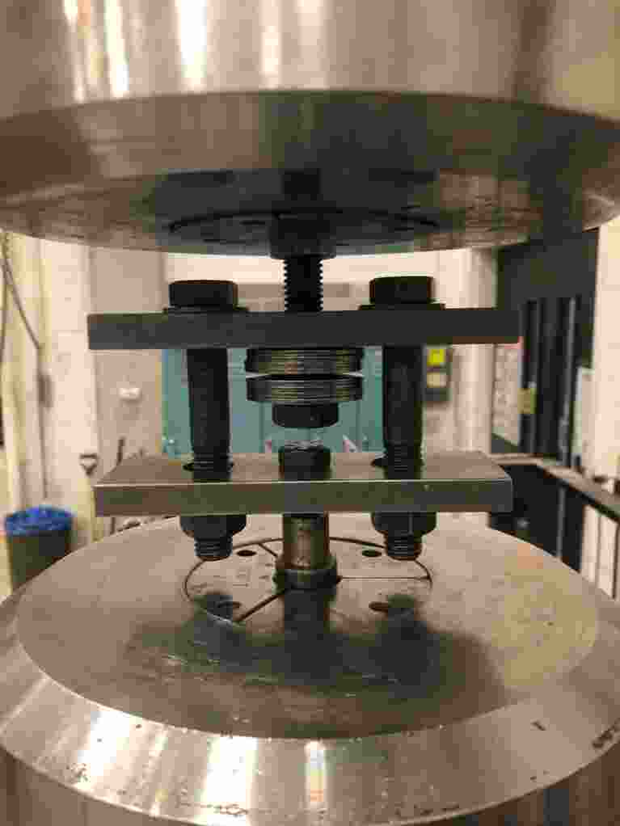
Material testing
Machine grip
Guide rod
K1875-G-086
2 units of 2U2D
Loading
frame
Material testing
Machine grip

Slide 16
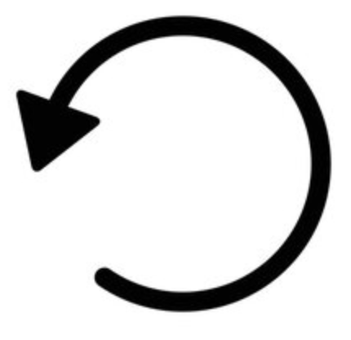
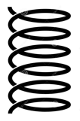
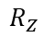
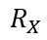
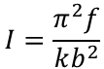
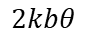
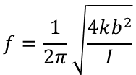
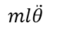
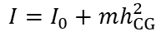
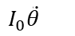
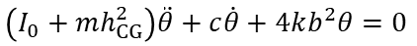
θ
Free body diagram
Center of mass
$$ml\ddot{θ}$$
$$I_{0}\ddot{θ}$$
h_{CG}
b
b
$$R_{X}$$
$$R_{Z}$$
k
k
$$2kbθ$$
$$2kbθ$$
Equation of motion:
$$\left(I_{0}+mh_{CG}^{2}\right)\ddot{θ}+c\dot{θ}+4kb^{2}θ=0$$
Mass moment of inertia about center of rotation:
$$I=I_{0}+mh_{CG}^{2}$$
$$f=\frac{1}{2π}\sqrt{\frac{4kb^{2}}{I}}$$
$$I=\frac{π^{2}f}{kb^{2}}$$
Frequency,
from which

Slide 17
CVT base
Guide bolt
2,120 lb/in springs
at four corners
Floor

Slide 18
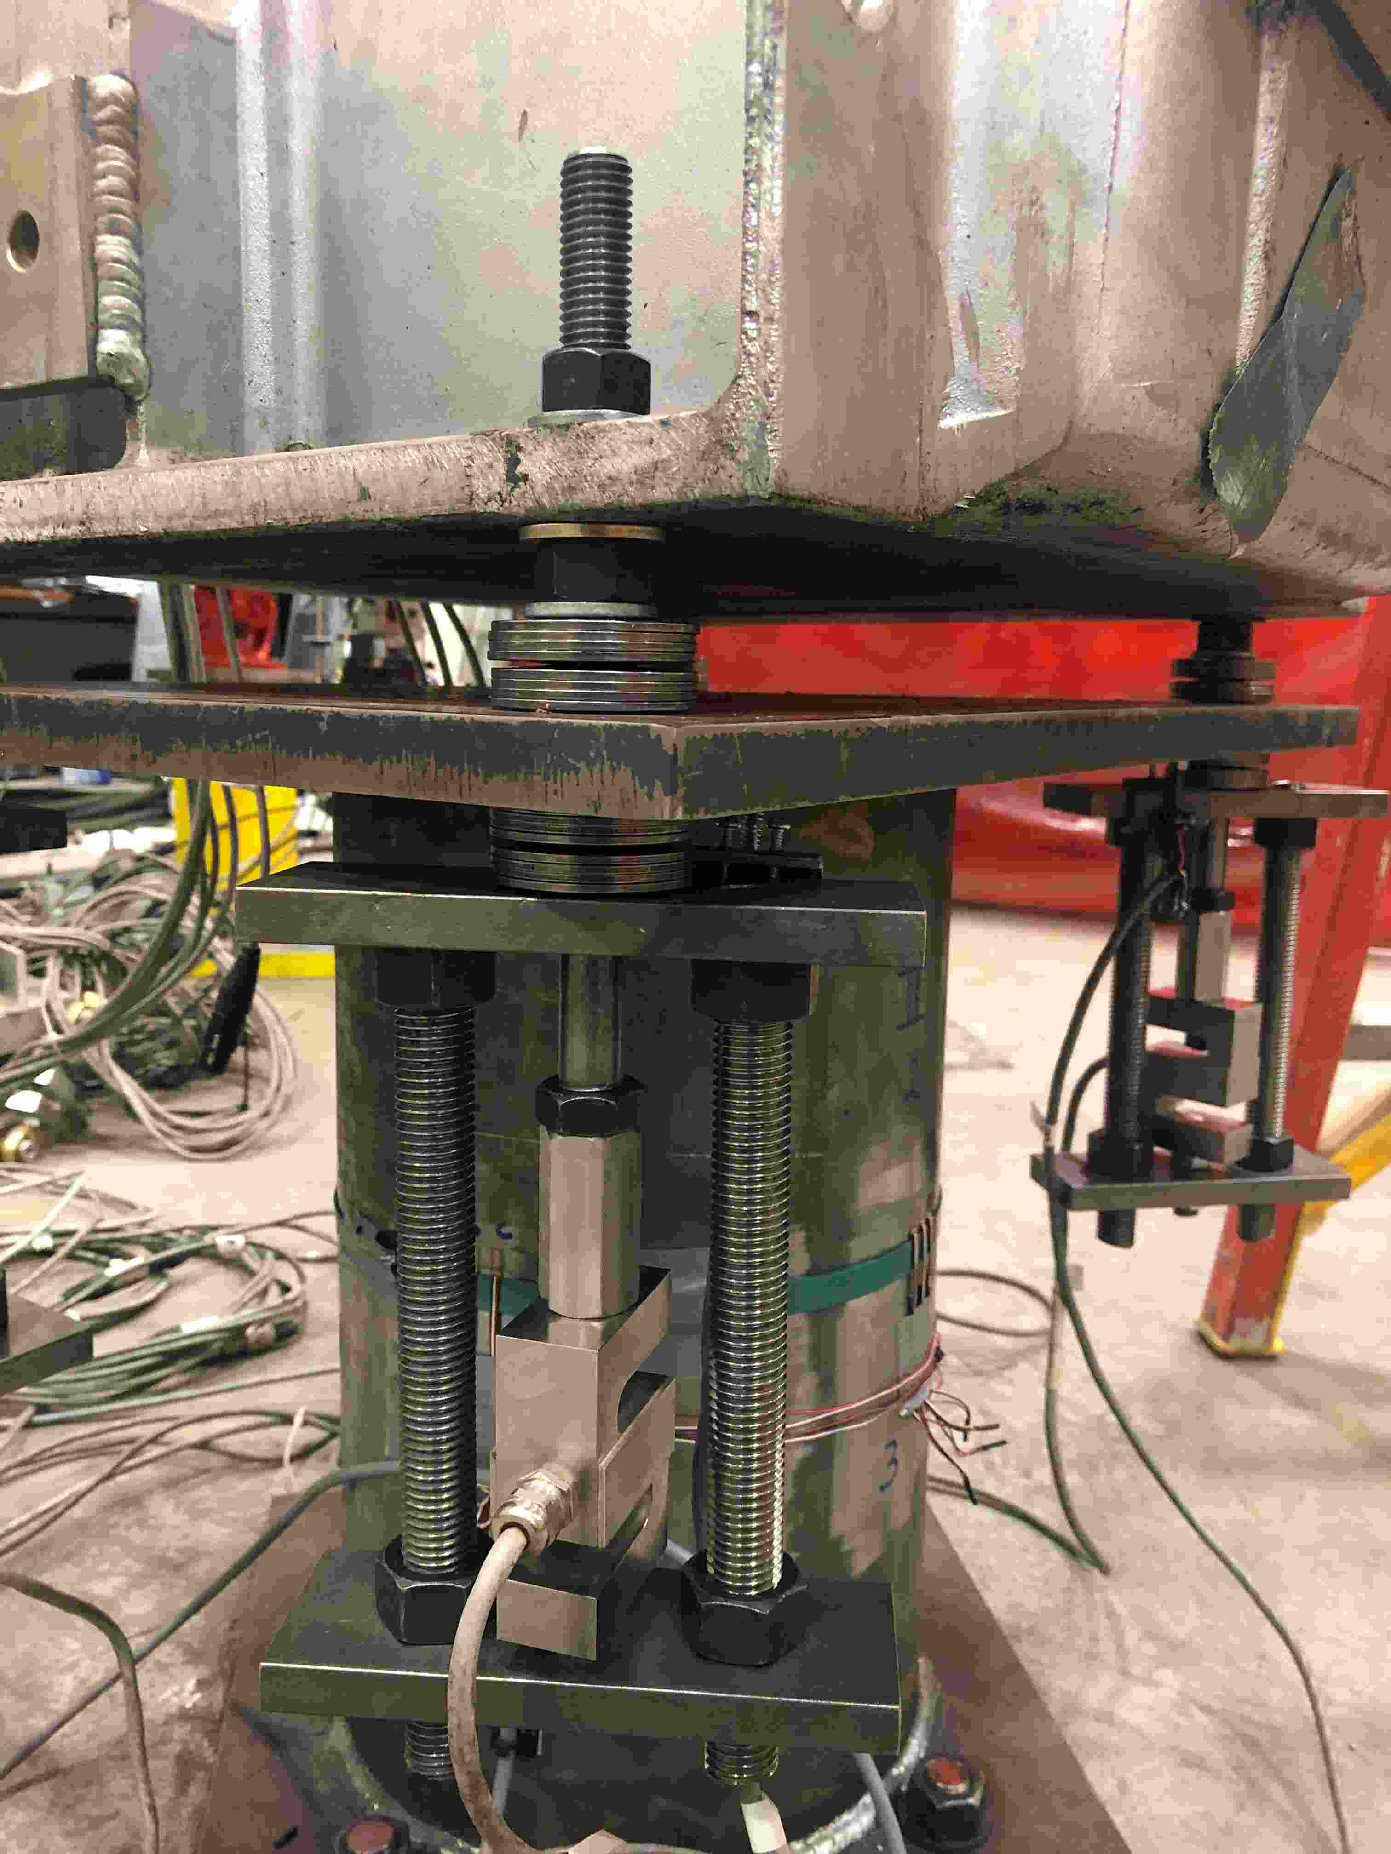
Z
Nut used to apply preload
Y (NS)
Spool top plate
X (EW)
K1875 2 units of 2U2D
Spool
3/4in rods to complete load path
Load cell

Slide 19
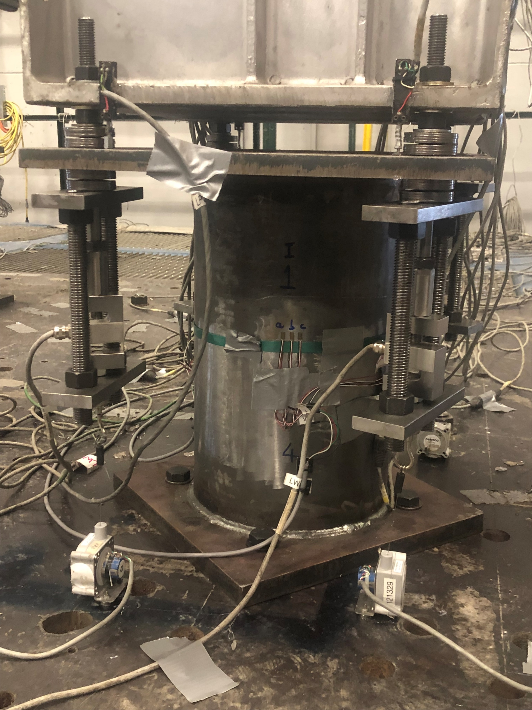
Top stack deformation
4 LWAs, each corner
Moment, X and Y
Z
Spool
Y
X

Slide 20

Top acceleration
and displacement, X and Y
Mid acceleration, X and Y
Strains at Bushing base
N, S, E and W
CVT box acceleration, Z
in N, S, E and W
Z
Y
X

Slide 21
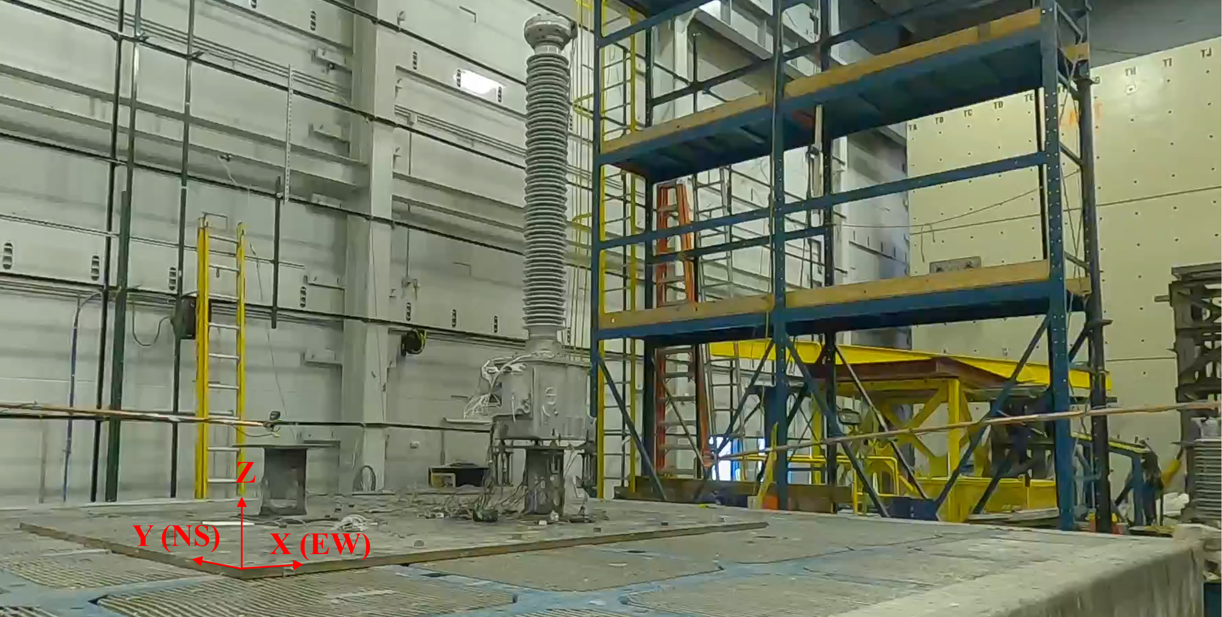
CVT
Belleville washers
Spool
Shake table

Slide 29
